Slide 1
Bike-sharing Rental Demand Prediction
Final Project Report
Data Science & Machine Learning Implementation

Slide 2
Problem Statement
- Ensure stable supply of rental bikes in urban cities.
- Predict demand based on weather, season, holidays, and time.
- Goal: Improve mobility comfort and customer satisfaction.

Slide 3
Exploratory Data Analysis (EDA)
- Dataset: 17,379 records with 17 features.
- Data Cleaning: Handled hidden missing values ('?') in weather features.
- Date Parsing: Corrected DD-MM-YYYY format alignment.
- Outlier Detection: Identified variance in counts during peak hours.

Slide 4
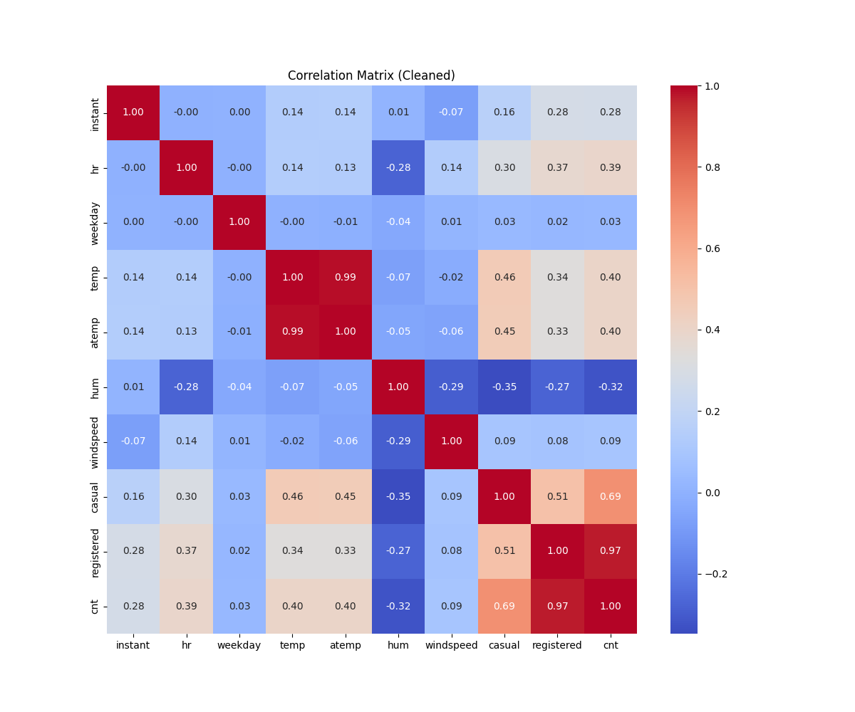
Data Visualization
- Analyzed feature correlations using Heatmaps.
- Observed strong relationship between temperature (temp/atemp) and rental counts.
- Time-series trends show clear seasonal and hourly patterns.

Slide 5
Feature Engineering
- Categorical Encoding: One-Hot Encoding for 'season' and 'weather'.
- Cyclic Encoding: Sin/Cos transformation for hour and month to capture periodicity.
- Normalization: Min-Max Scaling for numerical features like humidity and windspeed.

Slide 6
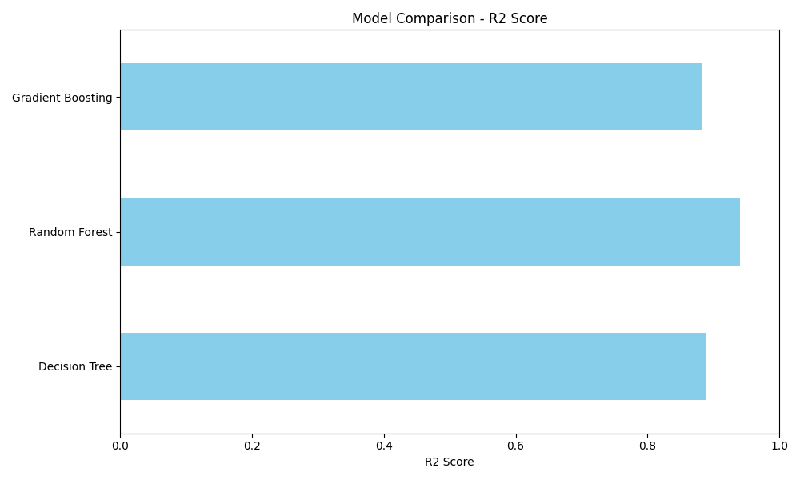
Model Construction
- Evaluated Decision Tree, Random Forest, and Gradient Boosting.
- Metrics: MAE, RMSE, and R-squared.
- Random Forest outperformed others with R2 of 0.94.

Slide 7
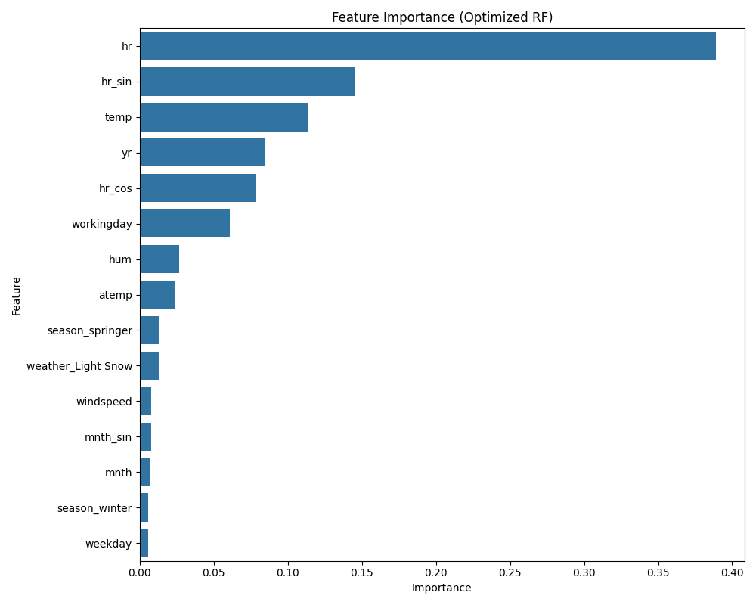
Hyperparameter Tuning
- Randomized Search performed on Random Forest.
- Parameters tuned: n_estimators, max_depth, min_samples_split.
- Final Model achieved high precision in capturing peak hour demand.

Slide 8
Model Deployment
- Deployed via Streamlit Web Application.
- Real-time interactive interface for demand Forecasting.
- Stable and scalable solution for urban mobility planning.

